Slide 1

Smart Logistics Optimization using Data Analytics
End-to-End Analytics Case Study
Presented by : Harisha | Data Analyst
Tools: MySQL | Python | Statistics | Power BI

Slide 2
Business Context
Company
Challenges
Impact
InsightFleet Logistics – mid-sized (1000) provider operating across 10 states.
Frequent shipment delays and long warehouse wait times
Reduced customer satisfaction, higher costs, and delivery inconsistencies.
Under- or over-utilized fleet assets
Limited operational visibility

Slide 3

Project Objective
Goal: Reduce shipment delays and optimize asset performance using data-driven insights.
1
Shipment performance and delay trends
2
Fleet utilization and Operational efficiency
3
Customer impact and revenue risk

Slide 4
Client Requirements
1
2
Shipment Performance
Operational Patterns
Identify delay causes, measure delivery reliability, and estimate revenue at risk.
Find peak congestion hours and day/month delay patterns.
3
4
Asset Utilization
Customer & Revenue Impact
Detect under- and over-utilized trucks.
Assess which customer segments face the most delays.

Slide 5




Tools & Methodology
Dataset Highlights
1.Timestamp : Date and time when the shipment event was recorded.
MySQL
2.Asset_ID : Unique identifier for each truck/vehicle (e.g., Truck_1, Truck_2).
Store and query logistics data, generate KPIs.
3.Latitude & Longitude : GPS coordinates of the truck/asset.
4.Inventory_Level : The actual stock level carried by the asset at that timestamp.
5.Shipment_Status : Status of the shipment (e.g., "In Transit", "Delivered", "Pending").
Python
6.Temperature : temperature recorded during transport.
EDA, data cleaning, statistical tests.
7.Humidity : Humidity level during shipment.
8.Traffic_Status : Traffic condition faced during transport (e.g., "Clear", "Heavy", "Detour").
9.Waiting_Time :Time spent idle (e.g., at checkpoints, warehouses, or traffic).
Statistics
10.User_Transaction_Amount : Monetary value of a single customer transaction.
Correlation and hypothesis analysis.
11.User_Purchase_Frequency : Number of purchases made by a user in a given period.
12.Logistics_Delay_Reason : Recorded reason for shipment delay (e.g., "Traffic", "Weather", "Mechanical Issue").
Power BI
13.Asset_Utilization : Percentage of truck capacity utilized (e.g., 80% means truck is almost full).
Visualize KPIs and interactive dashboards.
14.Demand_Forecast : Predicted demand (forecasted inventory requirement).
15.Logistics_Delay : Binary indicator (0 = On time, 1 = Delayed).

Slide 6

Data Preparation
Clean Data
Removed duplicates & handled missing values.
Format Timestamps
Converted timestamps to datetime.
Verify Integrity
Verified data integrity and summary stats.
Result: Clean, structured dataset ready for EDA.

Slide 7

Exploratory Data Analysis (EDA)
Correlation Insights:
No single variable strongly affects delays.
Delays likely result from multiple factors (traffic, waiting time, utilization).
Weak linear correlations suggest complex operational dynamics.
Conclusion: Delays are multifactorial, not driven by a single metric.

Slide 8
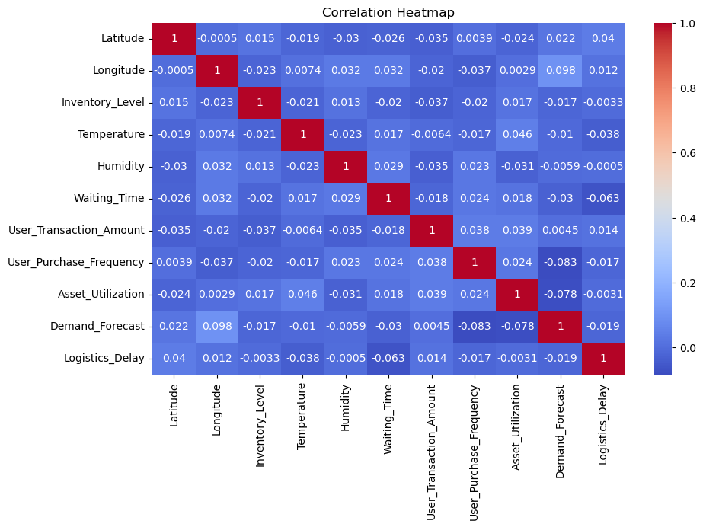

Slide 9
Business Questions Explored
What proportion of shipments are delayed?
1
Which variables most influence delay occurrence?
2
How do delays vary across days/times/seasons?
3
Which customer segments are most impacted?
4
What portion of revenue is threatened by delays?
5

Slide 10
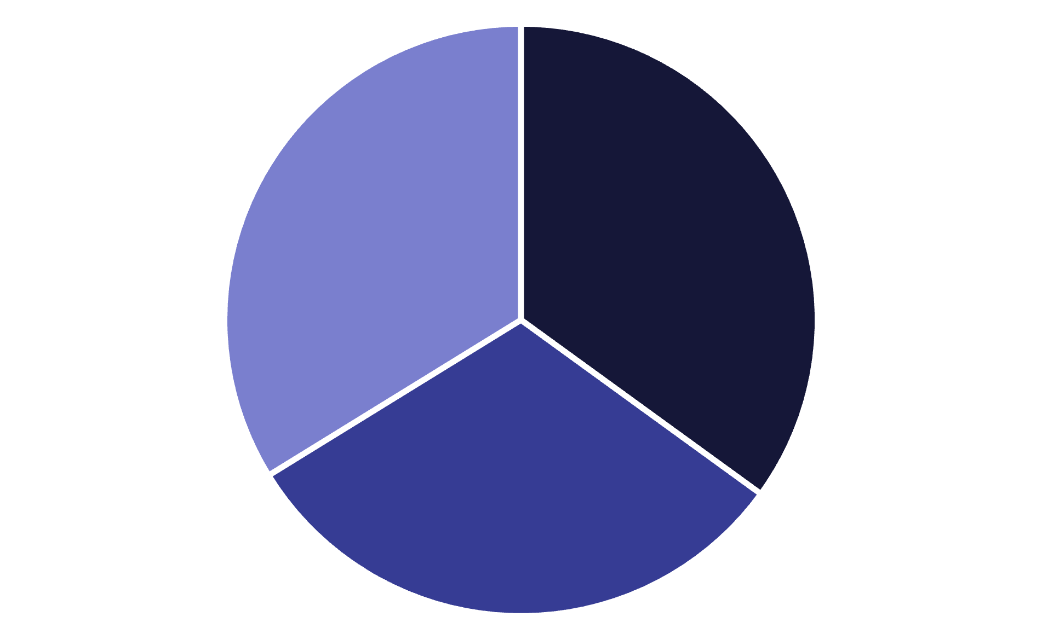
Shipment Performance Analysis :
Objective: Evaluate shipment reliability and delay distribution.
Delayed
In Transit
Delivered
The analysis reveals that 35% of shipments experience delays, a significant portion impacting operational efficiency. Approximately 31.2% of shipments are currently in transit, while 33.8% have been successfully delivered. This distribution highlights the critical need to address delay factors to improve overall delivery performance and customer satisfaction.

Slide 11



Financial Impact of Delayed Shipments
Analyzing the direct financial consequences of shipment delays reveals a significant portion of revenue is consistently at risk, impacting overall profitability and customer trust.
56.9%
43.1%
Revenue at Risk
On-Time Revenue
Portion of revenue directly impacted by shipment delays, leading to potential customer dissatisfaction and lost sales opportunities.
Revenue generated from shipments delivered on schedule, reflecting reliable service and positive customer experiences.
The total estimated revenue loss due to these delays amounts to approximately 170059.0 annually, underscoring the urgent need for optimization.

Slide 12
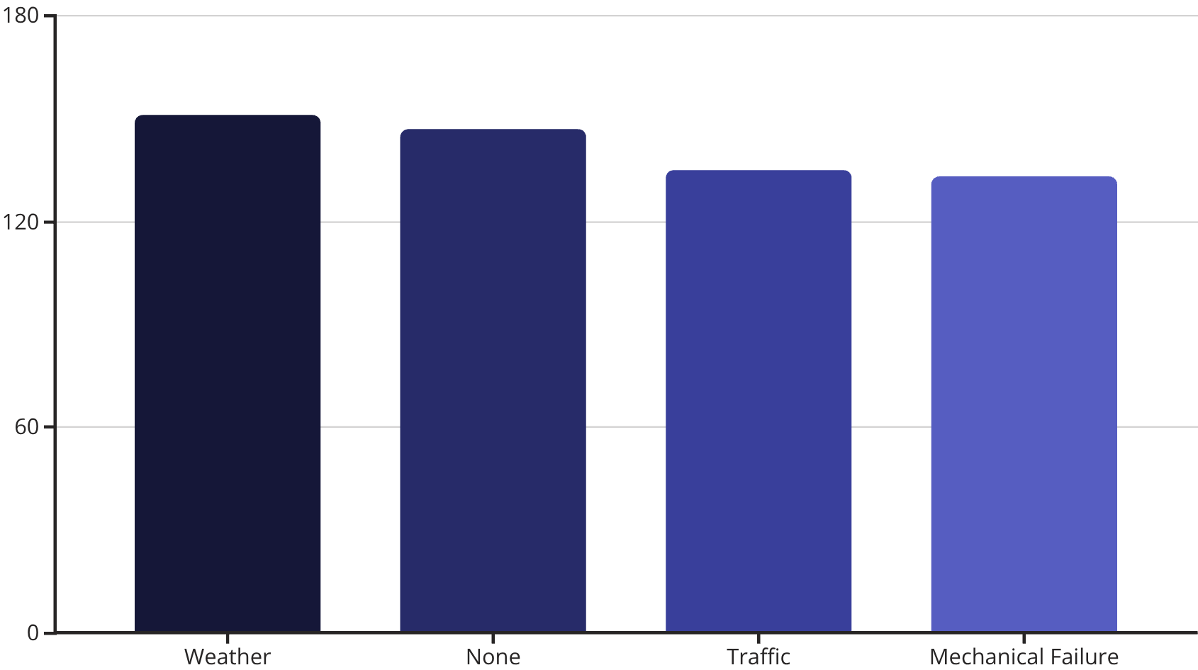
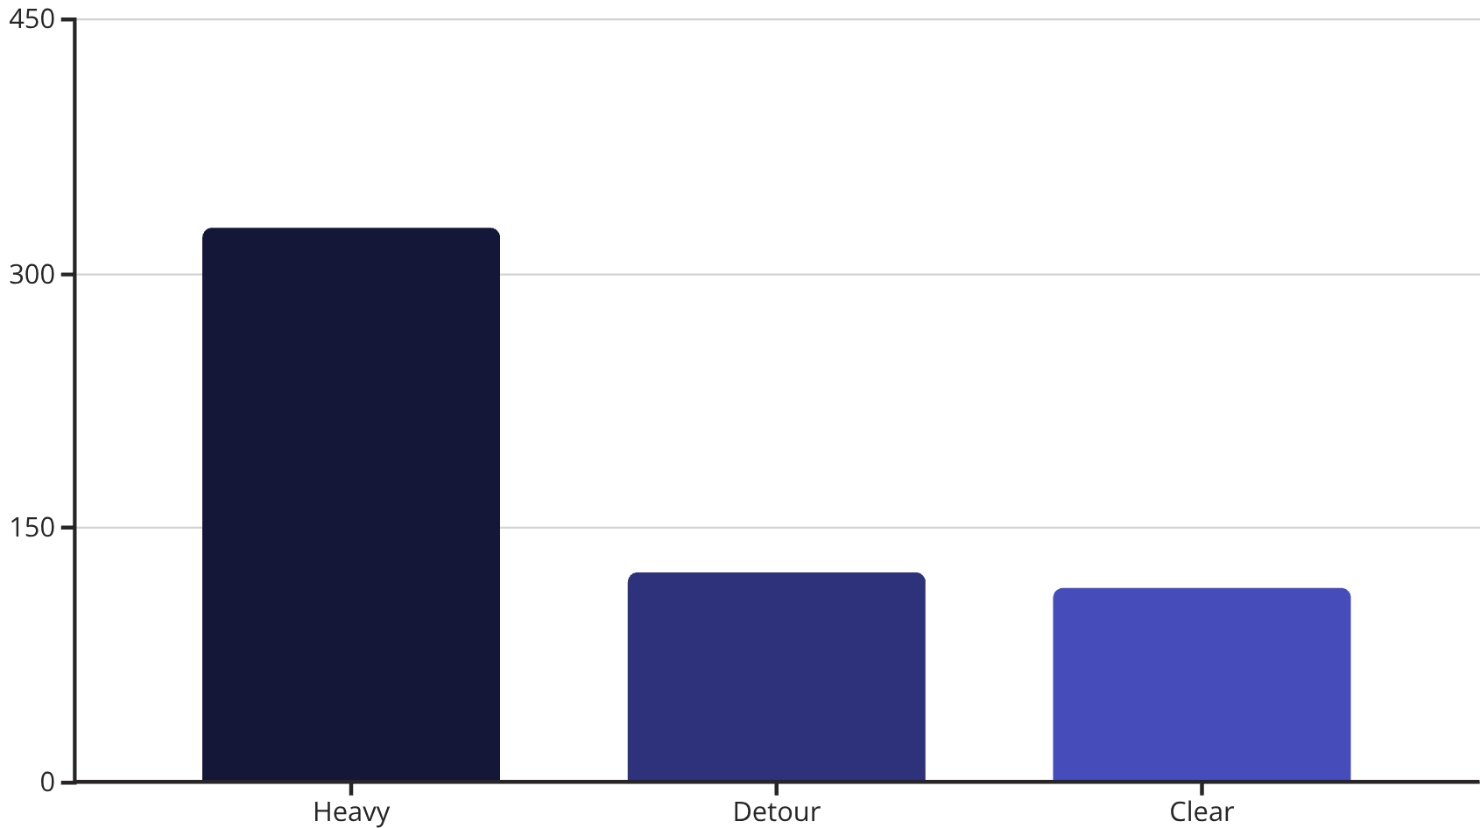
Key Factors in Shipment Delays
Understanding the primary reasons behind shipment delays is crucial for improving logistics efficiency. Our analysis reveals both direct causes and the impact of traffic conditions.
Main Delay Drivers
Traffic Status Impact on Delays
Weather conditions lead as the top external cause, closely followed by instances where no specific reason was recorded. Traffic and mechanical failures contribute significantly as well.
Heavy traffic is by far the biggest contributor to delays related to road conditions, indicating critical congestion points. Detours and even seemingly clear traffic also account for a notable number of delays.

Slide 13


Warehouse Waiting Times: A Key Driver of Delays
Our statistical analysis, validated by T-test results, reveals a significant correlation: delayed shipments consistently exhibit higher waiting times within warehouses.
This finding strongly suggests that optimizing and reducing these internal waiting periods is a direct and proven strategy to mitigate overall shipment delays.

Slide 14
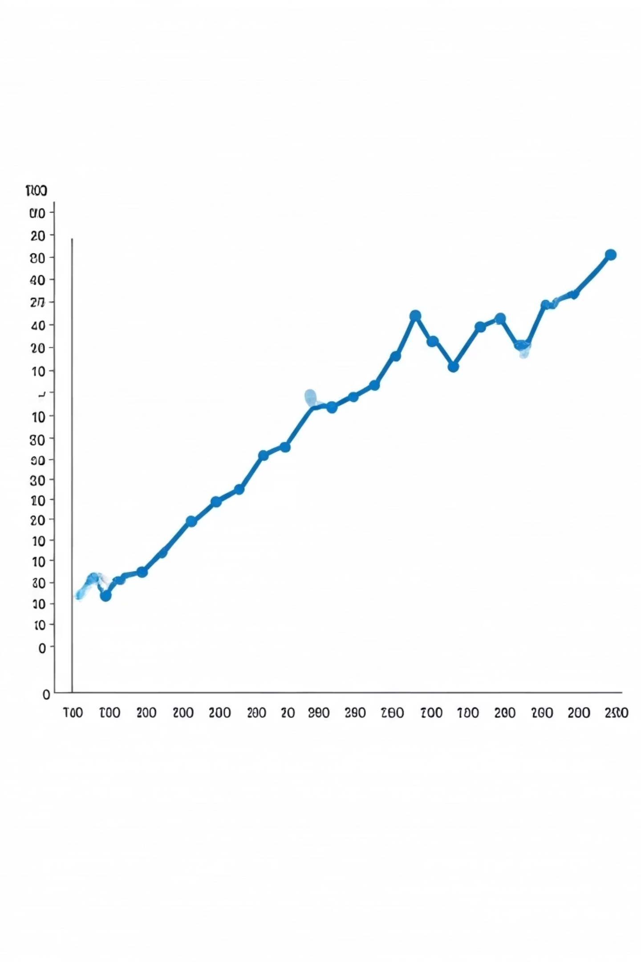
Operational Patterns
1
Peak Hours
2 PM – 7 PM
2
Problem Days
Tuesdays & Saturdays
3
Seasonal Spikes
June–July (summer)
Action: Adjust scheduling & staffing to mitigate peaks.

Slide 15
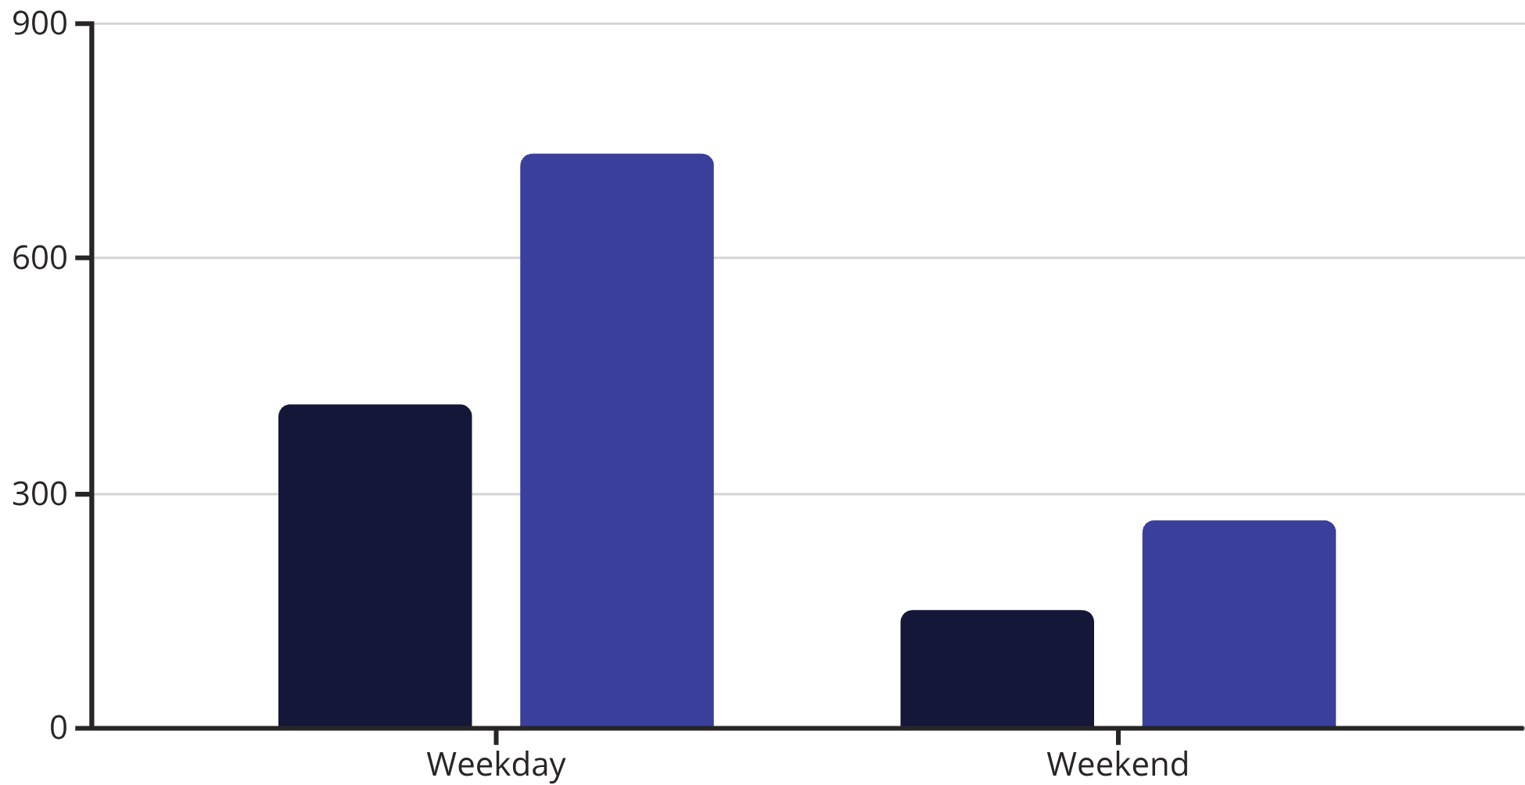
Shipment Delay Patterns: Weekday vs. Weekend
Our analysis indicates a consistent rate of shipment delays, whether operations occur on weekdays or weekends, suggesting underlying issues not tied to the day of the week.
Delayed Shipments
Total Shipments
Despite a higher volume of total and delayed shipments on weekdays, the percentage of delays remains remarkably similar: 56.48% for weekdays versus 56.93% for weekends. This suggests that the root causes of delays are not inherently linked to operational differences between these periods, but rather to systemic factors affecting all active shipping days.

Slide 16
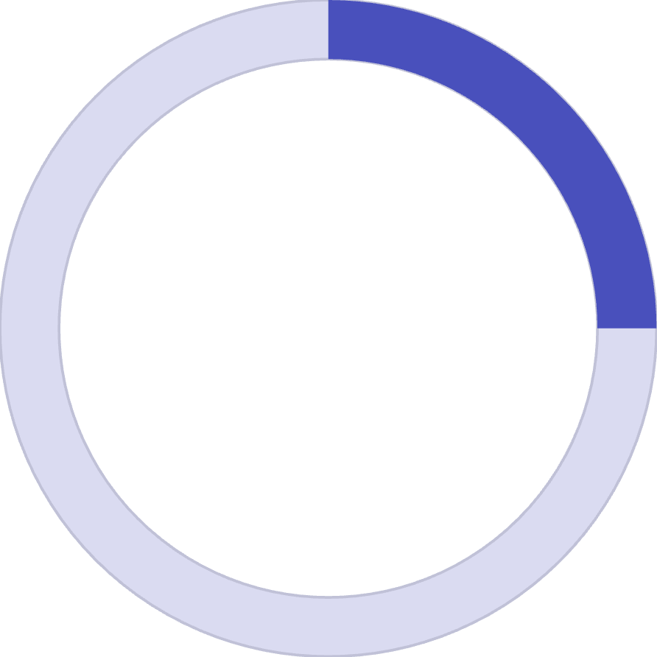
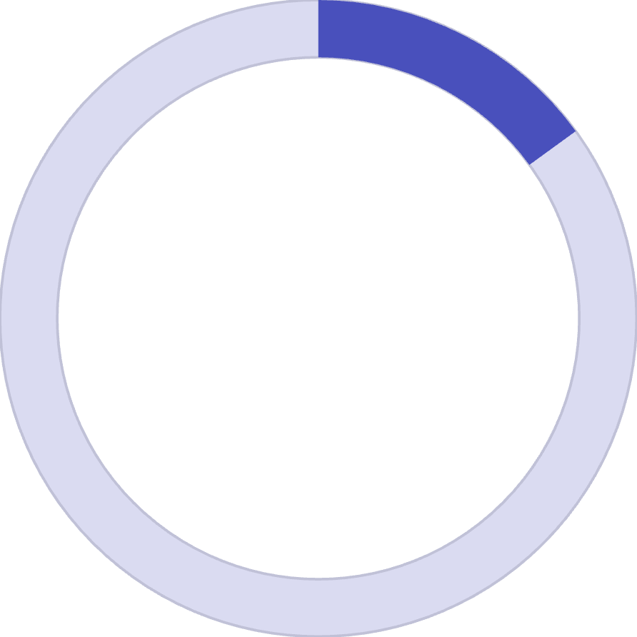
Asset Utilization Analysis
25%
15%
Under-utilized Trucks
Over-utilized Trucks
Less than 50% utilization
More than 90% utilization
Uneven workloads lead to higher maintenance risk.
Recommendation: Balance fleet utilization and schedule rotations.

Slide 17
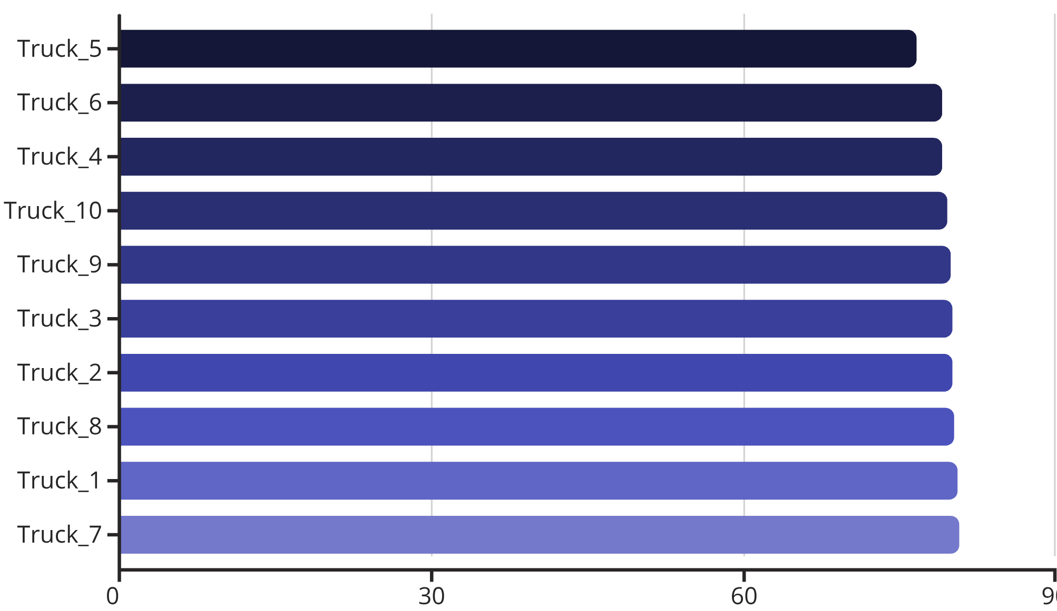
Individual Truck Utilization
A detailed look at the average utilization percentage for each truck in the fleet reveals consistent performance, with most assets operating within a tight efficiency range.
While most trucks maintain a high average utilization around 80%, Truck_5 shows slightly lower usage. Optimizing the distribution of tasks could help elevate its efficiency closer to the fleet average.

Slide 18


Weather's Limited Impact on Delays
Contrary to common assumptions, our analysis reveals that environmental conditions like temperature and humidity have a negligible effect on shipment delays.
Temperature Correlation
Humidity Correlation
A very weak negative correlation of -0.038 was found between temperature and logistics delays, indicating temperature changes do not significantly influence delays.
Humidity showed an almost zero correlation of -0.0005 with logistics delays, indicating no practical relationship.
This suggests that resources may be better allocated to addressing other, more impactful delay drivers rather than weather-related factors.

Slide 19
Asset Performance: Utilization Extremes
Identifying assets at the extreme ends of utilization helps pinpoint efficiency gains and mitigate risks.
0
238
Under-utilized Trucks
Over-utilized Trucks
No trucks currently fall below 50% utilization, indicating an efficient and optimized base deployment of our fleet.
Approximately 238 trucks consistently operate above 90% utilization, leading to increased wear, maintenance demands, and potential for driver fatigue.

Slide 20



Customer Segments: Delay Rates Remain Consistent
Contrary to expectations, statistical analysis reveals no significant difference in shipment delay rates across various customer segments, whether they are low, medium, or high-frequency buyers.
Low-Frequency Buyers
Medium-Frequency Buyers
High-Frequency Buyers
Delay Rate: 55.27%
Delay Rate: 61.82%
Delay Rate: 54.13%
Customers with fewer purchases experience similar delay percentages.
The segment with moderate purchase activity also faces comparable delays.
Our most loyal customers encounter delays at a rate consistent with other segments.
This indicates that loyalty level (frequency of purchase) does not significantly alter the chance of a shipment delay, suggesting that systemic issues affect all customer groups equally.

Slide 21





Power BI Dashboard Overview
On-time Rate
Delay Reasons
Average Waiting Time
≈120 mins
Fleet Utilization
Revenue at Risk
Features: Interactive drill-downs and real-time alerts for high-delay patterns.

Slide 22
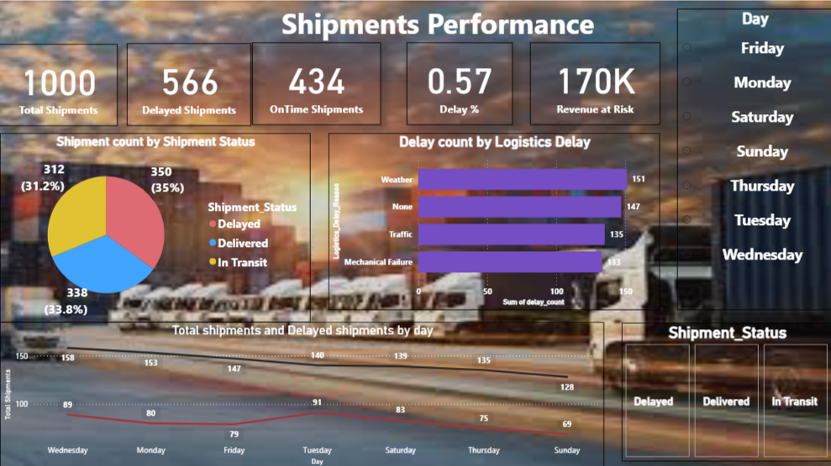

Slide 23
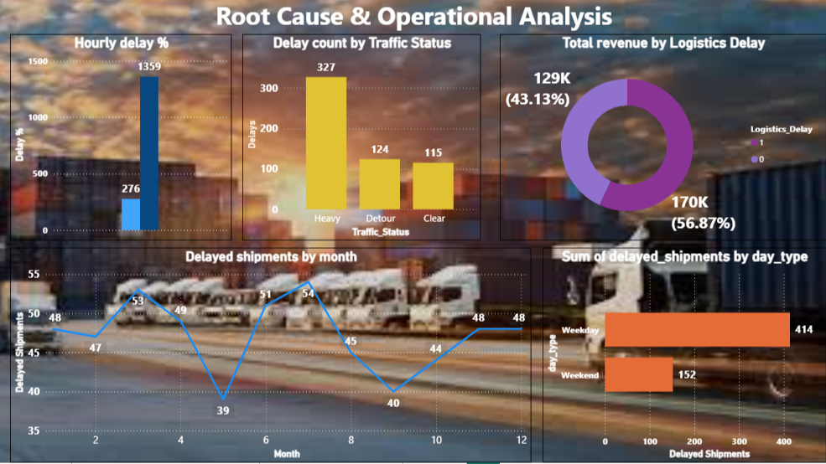

Slide 24
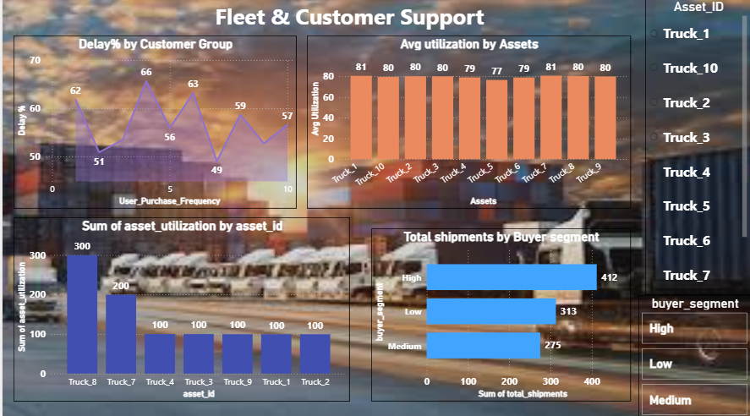

Slide 25
Key Insights Summary
1
Traffic Congestion
#1 delay cause (327 cases)
2
Warehouse Waiting Time
Key bottleneck
3
Weather
Minimal factor
4
Fleet Imbalance
Ongoing efficiency issue

Slide 26






Business Recommendations
Route Optimization
Implement live GPS routing
Reduce Waiting Times
Faster loading/unloading
Peak Planning
Allocate more staff Tue/Sat and afternoons
Fleet Balancing
Optimize truck assignments
Customer Retention
Prioritize medium-frequency clients
KPI Monitoring
Track "Revenue at Risk" continuously

Slide 27
Next Steps & Projected Outcomes
Next Steps
Business Impact
Integrate real-time traffic & weather APIs
Reduce delays by 20–25%
Deploy predictive maintenance models
Improve fleet balance by 15%
Automate delay alerts
Increase on-time delivery satisfaction
Regular dashboard reviews with management
Enable data-driven logistics strategy

Slide 28

Thank You
Turning logistics challenges into data-driven opportunities.

